Slide 1
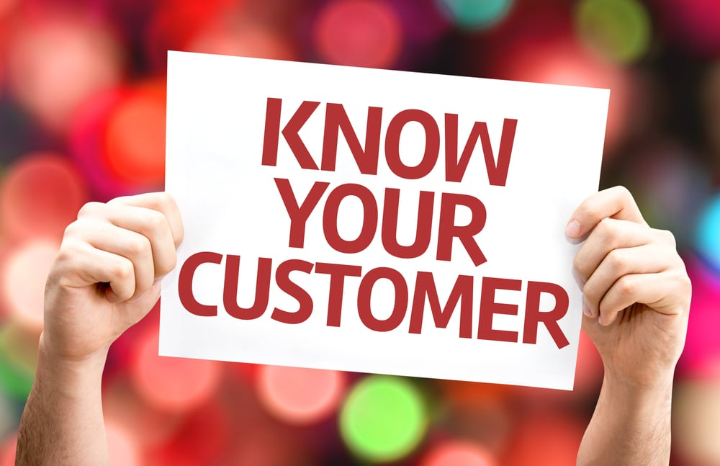
CUSTOMER SEGMENTATION

Slide 2
CUSTOMER SEGMENTATION
Customer Segmentation is the process of division of customer base into several groups of individuals that share a similarity in different ways that are relevant to marketing such as gender, age, interests, and miscellaneous spending habits.

Slide 3
WHY CUSTOMER SEGMENTATION?
Segmentation of market is an effective way to define and meet customer needs
A customer segmentation model allows for the effective allocation of marketing resources and the maximization of cross and up-selling opportunities.

Slide 4
Clustering methods
K means clustering
DBSCAN Clustering

Slide 5
Silihouette score
Silihouette score is used to evaluate the quality of clustering algorithm and density of clustering algorithm

Slide 6
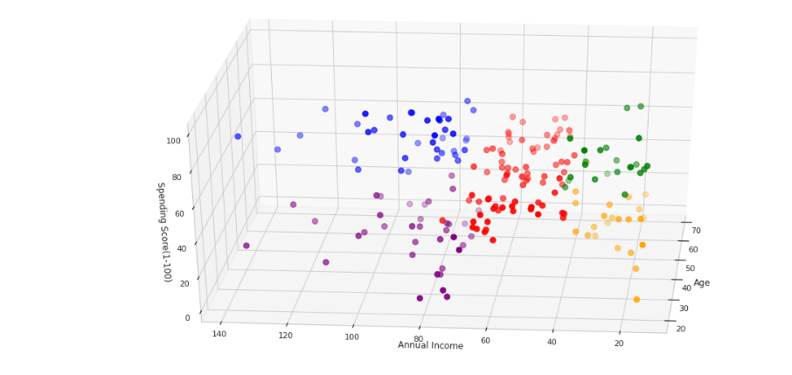
K means clustering
K Means Clustering is the most common and simplest Machine learning algorithm and it follows an iterative approach which attempts to partition the dataset into different “k” number of predefined and non-overlapping subgroups where each data point belongs to only one subgroup according to their similar qualities.
K means clustering silhouetee score 0.49

Slide 7
Conclusion of k means clustering
KMEANS SILHOUETTE SCORE
X1 = 0.499(between Age and Annual income)
X2 = 0.553(between Annual Income and Spending Score)
X3 = 0.440(among Age , Annual Income , Spending Score)

Slide 8
DBSCAN Clustering Algorithm
DBSCAN is a density-based clustering algorithm that works on the assumption that clusters are dense regions in space separated by regions of lower density. It groups 'densely grouped' data points into a single cluster.

Slide 9
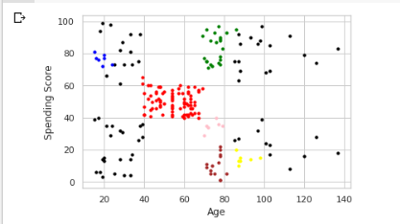
DBSCAN CLUSTERING SILHOUETTE SCORE
SCORE = 0.27

Slide 10
Comparison of results and Conclusion
K-Means Clustering Silhoeutte Score is 0.49
DBSCAN Clustering Silhoeutte Score is 0.27
Finally, we have tried two algorithms. K-Means clustering has the best Silhouette compared with DBSCAN Clustering . So K-Means clustering is appropriate for Customer Segmentation compared to DBSCAN Clustering method.

